Slide 1
PROJECT WARMUP ON “PRICE COMPARISION APP”
ABHI SHAH(100902154)
PREET PATEL (100897482)
HIREN OZA (100898363)
MAYUR MARWADI (100896944)
DARSHAN GHOGHARI (100897771)

Slide 2

Project Definition and overview.
Ecommerce Web application must be developed that comprise of frontend, backend and AI component in it.
Frontend web application should have dynamic web pages that must be same as real ecommerce website same as “Amazon”, “Walmart”, “Fresco”.
Backend should have Rest API that will interact between database, Frontend over the http request.
AI component will use Computer Vision when user uploads image which it identify the user item and then it will compare that item with three/ two ecommerce website price and return the item with lowest price from the ecommerce website.

Slide 3
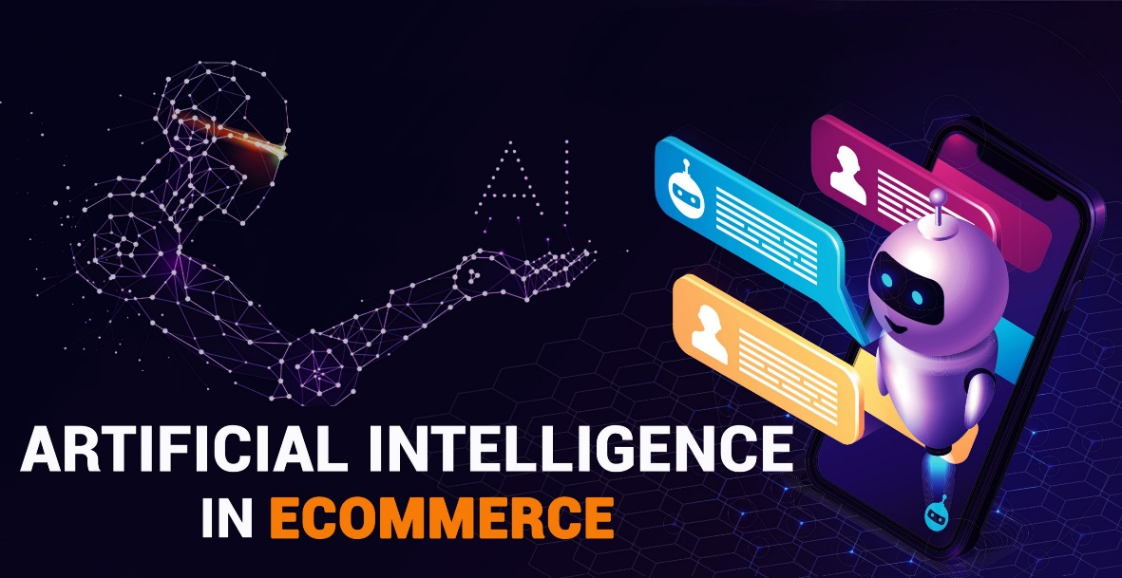
Project Functionalities and stages.
Our project is divided into two main steps:
Ecommerce website – Develop and integrate the frontend and backend functionality of ecommerce website.
AI functionality – Add Computer vision feature which will identify the image which user will upload and then will call API which will interact with other ecommerce API to get list of items based on price.

Slide 4

E-commerce site
Frontend
Backend
Log in page
Product List
Cart page
Authentication
User Creation
History

Slide 5

Frontend Functionality and technology.
There are few steps that need to be done to implement website. As this is complex ecommerce website so we will choose “Angular 12+” to implement the frontend website.
We will implement Login page (Authentication), product list page where user will search the product and it will show the list of product available in inventory, price comparison page – this page user can upload image and based on image AI will identify the object and will determine the name of item that user is looking for which will call third party API to get list of that item that are available in their inventory with lowest price.
User can add that item to their Cart (Cart page), history page that will show list of product in their inventory. Payment page that will allow user to pay. (We will add payment gateway if we have time to implement that).

Slide 6

Backend Functionality.
Here is the list of API endpoints that we will implement in Flask Rest API.
Authentication endpoint:- /api/authentication – Post API – {username, password} – will identify the user and if user is authenticated return JWT token.
Create user :- /api/adduser – Post API – {username, email, password}- will create new user.
getInventoryList : /api/getInventoryList – Get API – (user contains search item)- will return list of Inventory items.
AddItemInCart : /api/addInventoryItemInCart – Post API – {userId, itemId}.
placeOrder : /api/placeOrder - POST API – {userId, list of itemId separated by ‘comma’}

Slide 7
Backend functionality continue…
api/getUserhistory – Get API – /userId – will get list of items that purchased by user.
Here, as we scrutinized that if we want to use real time API of “Amazon” and “Wallmart”, they are charging the monthly subscription. Amazon is giving API key for free but we have to fill the Amazon Associate page- they are not providing their real time data (store data) for education, we have to become Associate of amazon to get API key.
“link is here”: https://elfsight.com/blog/2020/05/how-to-use-amazon-ecommerce-api-examples-and-pricing/

Slide 8
Backend functionality continue:-
To overcome that, we will implement two ecommerce api as third party that will have image, name, price of that product. This step is last step that we will integrate if we get the time, this api will have 10 items.
We investigated that other free fake api are also providing the endpoint to consume, https://balajidharma.medium.com/free-store-api-for-developers-to-practice-front-end-e-commerce-development-fcf5b75e4982

Slide 9

Database:
We will use PostgreSQL as a database and we will create below tables:
User
Inventory – contain item details with images.
Cart
ItemUpload – contain image uploaded by user.
Ecommerce-1
Ecommerce-2

Slide 10

AI Computer Vision .
We will use Tensorflow, keras library that will identify the item based on image and return item name.
We still need to check which algorithm will be used to identify the item.

Slide 11
Use case Evaluation.
Here, we will define limited scope of around 10 to 15 items such as fruits, vegetable and we will train the computer vision model to identify the item uploaded by user. As currently, we do not have plan to purchase api key for existing real world ecommerce data, so we will develop dummy data for such 15 items in 3 e-commerce database and call the api to fetch price of each item based on selected uploaded item. So based on that user can verify the item and evaluate the functionality and reliability of the project.

Slide 12
Thank you

